Slide 1
Immigration Enforcement in Church spaces
"Injustice anywhere is a threat to justice everywhere. We are caught in an inescapable network of mutuality, tied in a single garment of destiny. Whatever affects one directly, affects all indirectly."
Re. Dr. Martin Luther King, Jr. “Letter from Birmingham Alabama jail,” April 16, 1963.
Dr. Helen H. Davis*
Disclaimer: I am not an attorney and I only offer information, not legal advice

Slide 2

In our Churches
Immigration officers can now enter the PUBLIC areas of our churches
Immigration officers can arrest individuals in public areas with an administrative warrant
Officers cannot enter areas marked private or that are considered private—such as offices, supply closets, or any other spaces not for public use—without a SIGNED JUDICIAL warrant

Slide 3
In our Churches: Have a plan
  Identify public and private spaces
  Clearly mark all private spaces by adding “Private,” “Staff Only,” or similar signs and adding locks to the doors
  Decide what happens if ICE shows up at your church
    Assign roles for key members: who will speak with officers, who will record, who will report. Knowing roles in advance is helpful
    Make sure everyone knows the plan and also knows the locations of the private spaces
  If ICE is active in your community, you may want to have a citizen or two monitor parking lots since ICE frequently targets folks in parking lots so that they do not have to deal with the rules of entering buildings. If agents are visible, have a team ready to be present in parking lots or to alert congregation members

Slide 4
In our Churches
  The person liaising with ICE should:
    Ask ICE why they are present
    Review any ICE paperwork
      Make sure that the person knows the difference between types of warrants
      ICE cannot arrest someone without an administrative warrant without additional evidence
      ICE cannot enter any private spaces without a judicial warrant
    If ICE has no paperwork, calmly ask them to leave
    Remind your congregants that they do not have to speak and ask the ICE officers to interact with you
    Document details of the interaction: ask for names and badge numbers
    As soon as ICE officers leave, immediately document everything you can about the visit in writing or via recording

Slide 5
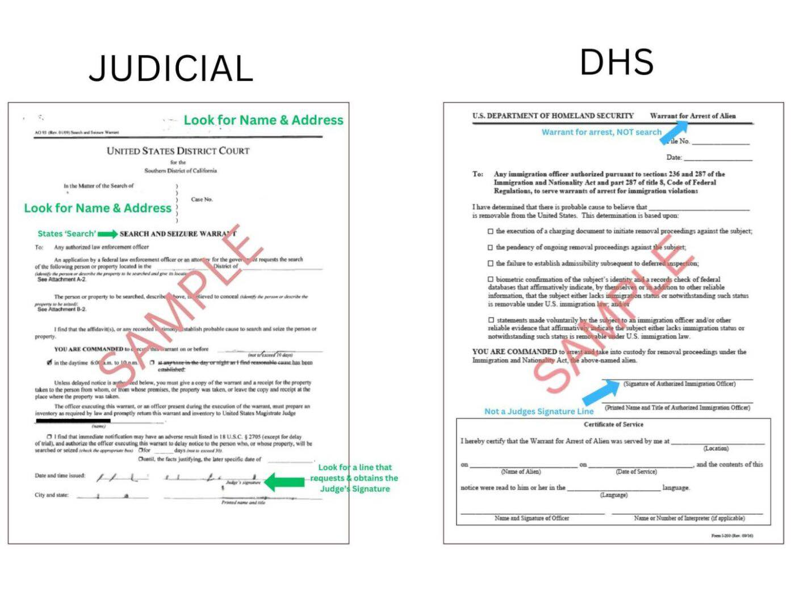
Types of Warrants

